Slide 1

Group Informatics: Design, Research and Blended Data Methodologies
Sean P. Goggins, Ph.D
&

Slide 2

Finding Connections – Animals? People? Snowmobiles? Overwhelmed.
The beach is different than the frozen tundra – But they both have footprints!
A rescue patrol has different needs than a tourist
What is our theory for *guessing* whose steps to follow?
Notes:
Knowing where others have been is of tremendous value in some situations. If you are dropped in the Wilderness of Alaska, following footsteps could save your life. I started my research trying to understand how small groups come together and work when there is little evidence other than discussion that they are even together. As I studied these groups, I came to recognize four dimensions of their interactions and their behavior that are distinct from small groups that exist in the face to face world:
Finding implicit connection is difficult, because most systems do not log and report implicit connections; by which I mean acts of reading or sharing the same artifacts, etc.
Identification with the group is powerfully influenced by the participants, but also by other experiences we have had in different kinds of technologically mediated groups. We all learn what to expect from each other in face to face social settings and adapt. In the online world, these adaptations are different in each technical system; and each individual has an array of technical systems they become familiar with …. That shape their expectations and perceptions of each new system.
Github
Sourceforge
Most research is domain bound. I can read studies of online learning. I can read studies of distributed software organizations. Few studies cover more than one context and almost as few researchers systematically examine multiple contexts – The idea of thinking about technologically mediated groups in a domain and system agnostic way is little explored. This problem takes on two distinct forms in two fields I participate in
CSCW – A lot of research on a small set of massive social computing systems
CSCL – A lot of research focused on small, microstudies of systems that are not widely distributed or used at all. I call these the “artisan cheeses”. Most learning design is built around systems that are the artisan cheeses – made in limited quantities, facing obstacles to scalability
The connection between activities that are logged in these systems and existing theories are not executed systematically across studies even within a domain; again, making comparisons and innovation more difficult.

Slide 3


Prominent, Contemporary Example: MOOCs
Learning Technologies We use
Technologies We Use Every Day
How do we get from A to B?
Pain
Fun

Slide 4





State of Learning Technology Design
Learning Technologies We Use
The Technologies We Design And Research
Massive
Unfriendly
Artisan Cheeses
They do not scale

Slide 5




A Pragmatic Path
Learning Technologies
Signal and Noise
Group Informatics
Learning Technologies
Research
Where and How People Learn Now
Design based Research
Group Informatics and CSCL@Work
Studies Across Contexts
Notes:
From a design perspective, "big social data" is a way to frame how we make sense of the rich electronic trace data (logs) that are left behind in various learning environments; and then to use those logs to provide useful feedback to people about the learning that is taking place. Partly this is a social theory of learning framing, which is what my 2009 dissertation examines. In the four years since that once in a lifetime (for me) project, the scope of my inquiry has expanded to fields of software engineering, social media, computational linguistics, "big data" and virtual organizations. Furthermore, I have taken up projects focused on workplace learning and rural outsourcing firms that train their own workers. Why? Simply put, there is not enough signal solely in the study of how people learn in traditional, school focused contexts to identify the design ideas that are likely to push learning technology design forward to a breakthrough.
There are also institutional obstacles to the application of data science to learning that arise from learning technologies that are already in place. In one widely rejected article I wrote with Jonathan Foster, and which we each abandoned for different reasons, I argue that a fundamental issue in the slow market innovation of novel learning technologies centers on infrastructure. Not the first level technical infrastructure, or the second level process and interaction focused infrastructure, but infrastructuring around resource allocation within educational institutions. To date, we experience specific difficulties in trying new things at an institutional level because the human and capital costs to change are prohibitive. It takes time to turn a big boat, even at sea.
Given the institutional limitations, and my own ambitions for advancing learning technology through the systematic study of how people interact, form groups and build institutions in a virtual world, I have spent a number of years examining contexts outside formal learning environments. The work that is published and in progress brings a novel and I think important perspective to learning technology design. A perspective born of the deep study of how people learn in informal contexts; how non-learning focused virtual organizations function; and how people use social media to argue, share information and build connection in ways that we frankly do not yet understand.
I think one key, as it relates to "Big Social Data", is that if you want to understand learning and make learning technology better, you have to study how people learn. And that's mostly not in school. If you want to build better learning technology, you have to study technology people use and how they use it. And that's mostly not Blackboard or systems like it. IMHO.
----- Meeting Notes (1/21/13 19:25) -----
When you use the work example, point out the failures of the education system being studies not having impact in workplace or out of school environments…
Relevance to stay engaged is important … CSCL@Work feeds back into my fundamental approach that suggests that to discover learning where it is occuring…

Slide 6
Research Agenda
Design
Challenges
Digital Traces
Studies Across Contexts
Applying Lessons in Learning
Finding Signal
Infrastructure
Raw
Group Informatics
Notes:
I am using the notion of “interdisciplinary” in a very specific way. A key aspect of my research program is the claim that to design learning technologies, we are best served to study the technologies that people do use and enjoy using in all aspects of their lives. In particular, I study collaborative technologies across a range of domains; but I also study how people *learn* in daily life.
Challenges
Tons of log data; tons of data – How do you most effectively find what is important? How do users? This is a design question
People get used to systems. Institutions get used to systems. Therefore, researchers need to be creative with regards to how they address the difficulties people experience when asked to change systems
Examining Log data
Raw data has little signal
Group Informatics is a systematic methodological approach and ontology for finding signal across domains
I focus on empirical work across domains. Lots of studies
Current work is developing interventions that surface understanding from within learning domains
----- Meeting Notes (1/21/13 19:25) -----
Talk about broader organizational learning environments under "applying lessons learned" … and talk about the social impacts of learning that is happening in these different contexts.
Briefly enumerate some education terms and talk about specific projects… more and more learning occurs in contexts out of schools.

Slide 7

Learning Technology Design
Design
Research
“If you build it, they will come” – Kevin Costner’s character in Field of Dreams
“Supposing is good, and finding out is better” – Mark Twain
Infrastructure
Resources appear, too, as shared visions of the possible and acceptable dreams of the innovative, as techniques, knowledge, know-how, and the institutions for learning these things. Infrastructure in these terms is a dense interwoven fabric that is, at the same time, dynamic, thoroughly ecological, even fragile. —Bucciarelli, 1994, p. 131

Slide 8

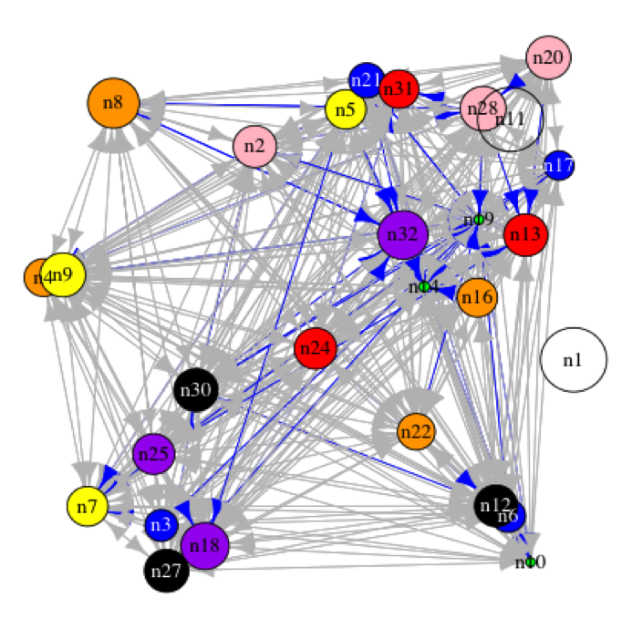
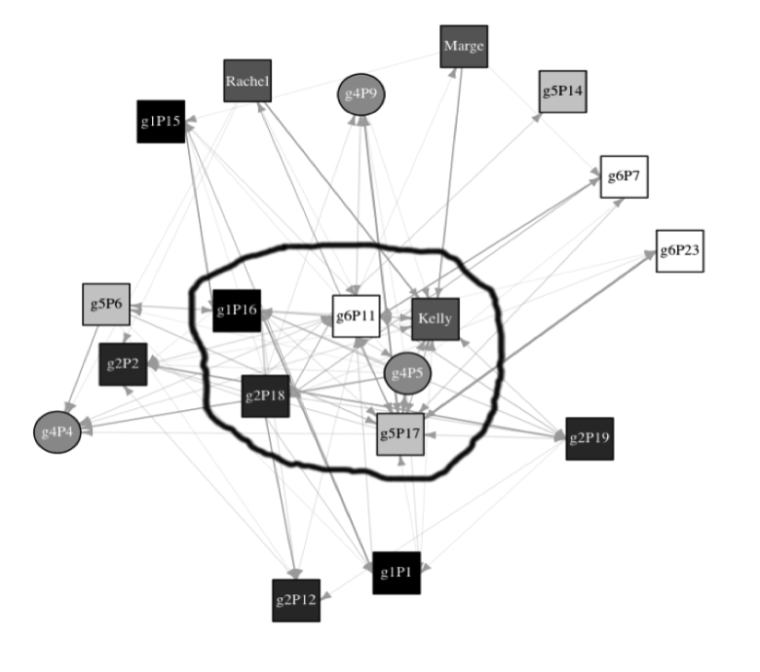
Leadership
Coordination
Knowledge Construction
Information Diffusion
Discourse
Negotiation
Knowledge Transfer
Challenges
Studies Across Contexts
Applying Lessons in Learning
Examining Log Data

Slide 9
The Group Informatics Path
Inductive Research
Qualitative
Quasi-Experimental
Abductive
Phenomenological
Design Experiments
Ethnographic
Increasing Generalizability
Drawing Inference from Electronic Trace Data (Logs)
Challenges
Studies Across Contexts
Applying Lessons in Learning
Examining Log Data
Notes:
----- Meeting Notes (2/8/13 16:21) -----
WE don't start with computation…

Slide 10
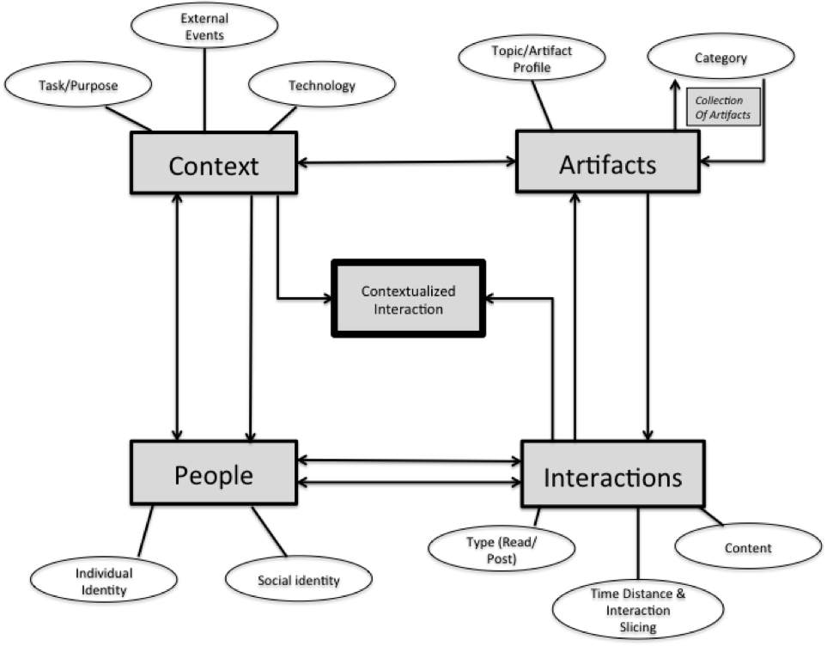
Group Informatics Ontology
Challenges
Studies Across Contexts
Applying Lessons in Learning
Examining Log Data

Slide 11
General Group Informatics Methodological Approach
Discussion Post
Open Coding
Connect to Theory
Time proximity
Topical proximity
Classification
Read
Response
Axial Coding
Aggregation of Posts by Topic, time or other
Weighted Network Analysis of Interactions
Challenges
Studies Across Contexts
Applying Lessons in Learning
Examining Log Data
Notes:
This slide would benefit from a key.
Also get rid of white on black.
----- Meeting Notes (1/21/13 19:25) -----
This slide is hard to read. Fix that.

Slide 12
Studies Building Indicators Across Contexts
Disaster Response
Software Engineering
Big Social Data (in 1 slide)
Challenges
Studies Across Contexts
Applying Lessons in Learning
Examining Log Data

Slide 13
Studies Across Contexts
Disaster Response
Key Construct: Information Brokerage
Challenges
Studies Across Contexts
Applying Lessons in Learning
Examining Log Data

Slide 14

Methodological Approach: Group Informatics
Discussion Post
Open Coding
Identification of Coordination Events
Time proximity
Topical proximity
Classification
Read
Response
Axial Coding
Aggregation of Posts by Topic
Weighted Network Analysis of Interactions
Data:
228 Posts with responses
898 Total Responses
Identify Key
Information
Brokers
Grounded Theory to Discover Themes
Weight Connections Based on Time Distance, Grouped
By Topic and informed by analysis of time distance between posts.
Grounded Theory to Identify Coordination In Forum and On the ground
Reduce Posts to
Interactions by
Topical Category
Methodological Approach
Notes:
----- Meeting Notes (1/21/13 19:32) -----
Relevance: Identifying who the information brokers are in a disaster response scenario

Slide 15
Key Findings
Coordination on the APAN forum is connected to action on the ground in Haiti
There are 23 categories of coordination in the forum. The top four are:
GIS Information Need / Provision (2 categories in top 5)
Ground Status Information
Medical
Transportation Logistics
The relationship between active information brokerage and forum use.
Crisis Informatics

Slide 16
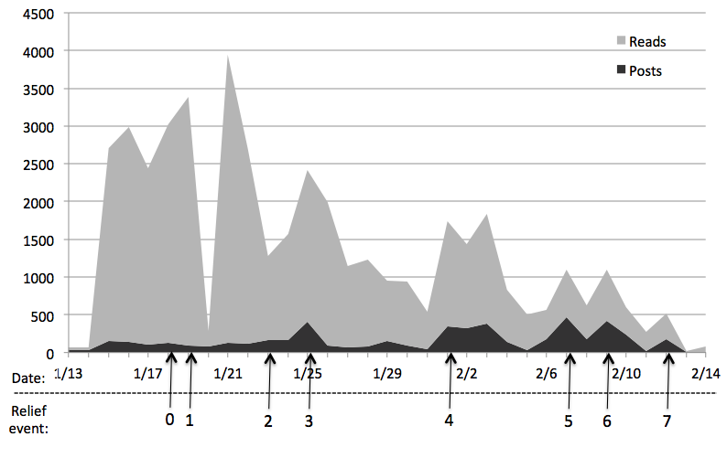
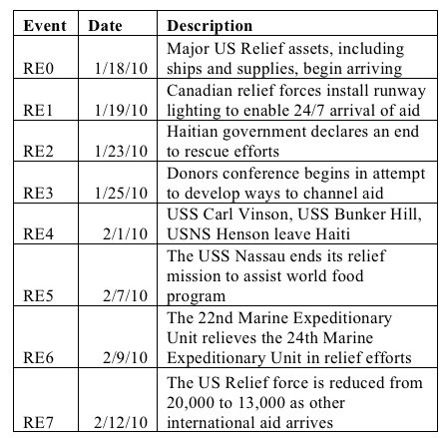
1: Coordination on the APAN forum is connected to action on the ground in Haiti
Crisis Informatics
Finding One
Notes:
First Half – Arrival Events. Notice the higher reading and lower posting.
Second Half – Departure events. Notice the lower reading and higher posting.
This communication change is related to NGO’s seeking information about contributing to the ongoing effort.
Coordination on the APAN forum is connected to action on the ground in Haiti
----- Meeting Notes (1/21/13 19:32) -----
This is important because it shows that activity within a coordination forum is connected to activity on the ground.

Slide 17
2: Heavily used for coordination work
Code | Count
GIS Information Need | 26
Ground Status | 26
Medical | 25
Transportation Logistics | 24
GIS Information Provision | 18
Crisis Informatics
Finding Two
Notes:
There are 23 categories of coordination in the forum. The top four are:
GIS Information Need / Provision (2 categories in top 5)
Ground Status Information
Medical
Transportation Logistics

Slide 18
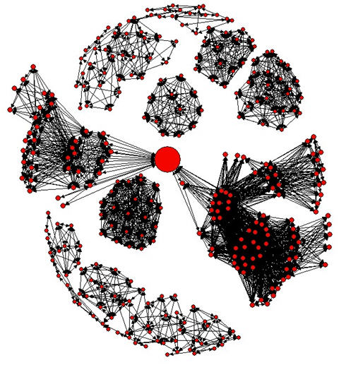
3: You Can’t Identify Who the Connectors are Just by Reading the Forum
Role and Name | Post Rank | Read Rank
APAN RFI Manager (Lucy) | 14 | 14
Government Contractor (Andrea) | 15 | 38
Senior GIS Specialist (Mike) | 35 | 58
NGO Executive Director (Ruth) | 26 | 468
Finding Three
Notes:
----- Meeting Notes (1/21/13 19:32) -----
This shows that the amount of participation is not a good measure of information brokerage, which in this context equates with "work getting done"
You are identifying the wrong people as key contributors if you just look at total posts.

Slide 19
Studies Across Contexts
Software Engineering
Key Construct: Coordination
Challenges
Studies Across Contexts
Applying Lessons in Learning
Examining Log Data

Slide 20
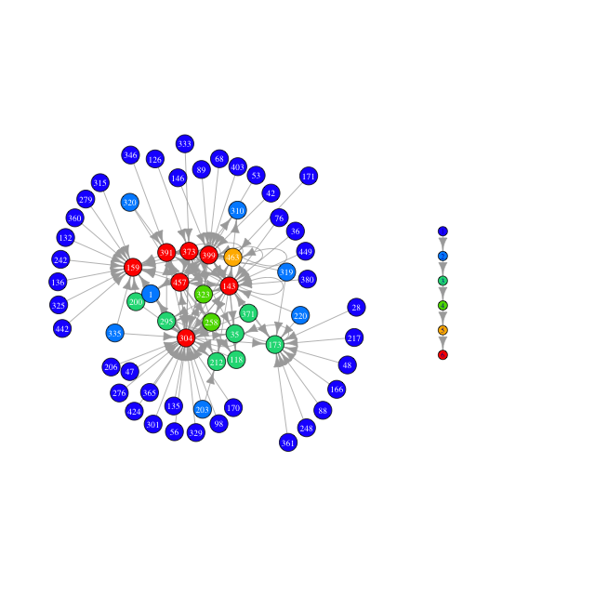
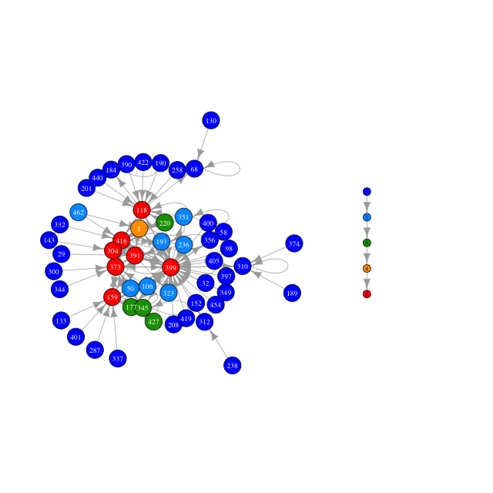
Mylyn - Changes Over Time
Release 2.0
Release 3.3
Challenges
Studies Across Contexts
Applying Lessons in Learning
Examining Log Data

Slide 21
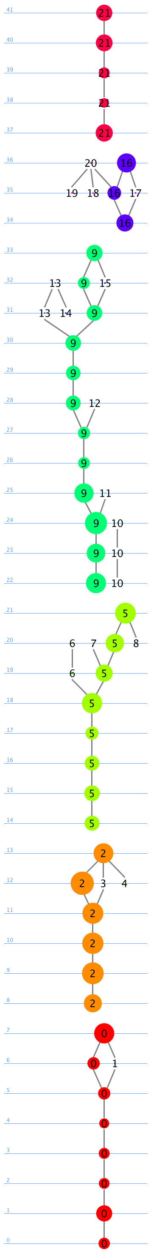
Topical Threading
NETWORK Analysis ++ Computational Linguistics and Machine Learning to Automatically
Identify Topics
Challenges
Studies Across Contexts
Applying Lessons in Learning
Examining Log Data

Slide 22
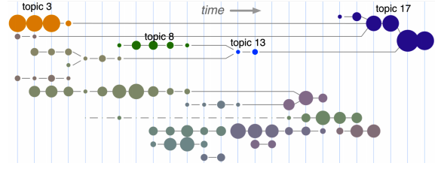
Topical Analysis + Levels of Participation
Challenges
Studies Across Contexts
Applying Lessons in Learning
Examining Log Data

Slide 23
Release One (2.0)
Code
Discussion
Talk
Release 1
Work
Google Summer Coder
304, 373, 399 & 143 form
The Strongest Connections
In both networks
Red = Bug Commenter
Blue = Bug Opener
Challenges
Studies Across Contexts
Applying Lessons in Learning
Examining Log Data

Slide 24
Release 8 (3.3)
Discussion
Code
Release 8
Talk
Nobody is
“Just Blue”
Work
Red = Bug Commenter
Blue = Bug Opener
Challenges
Studies Across Contexts
Applying Lessons in Learning
Examining Log Data

Slide 25
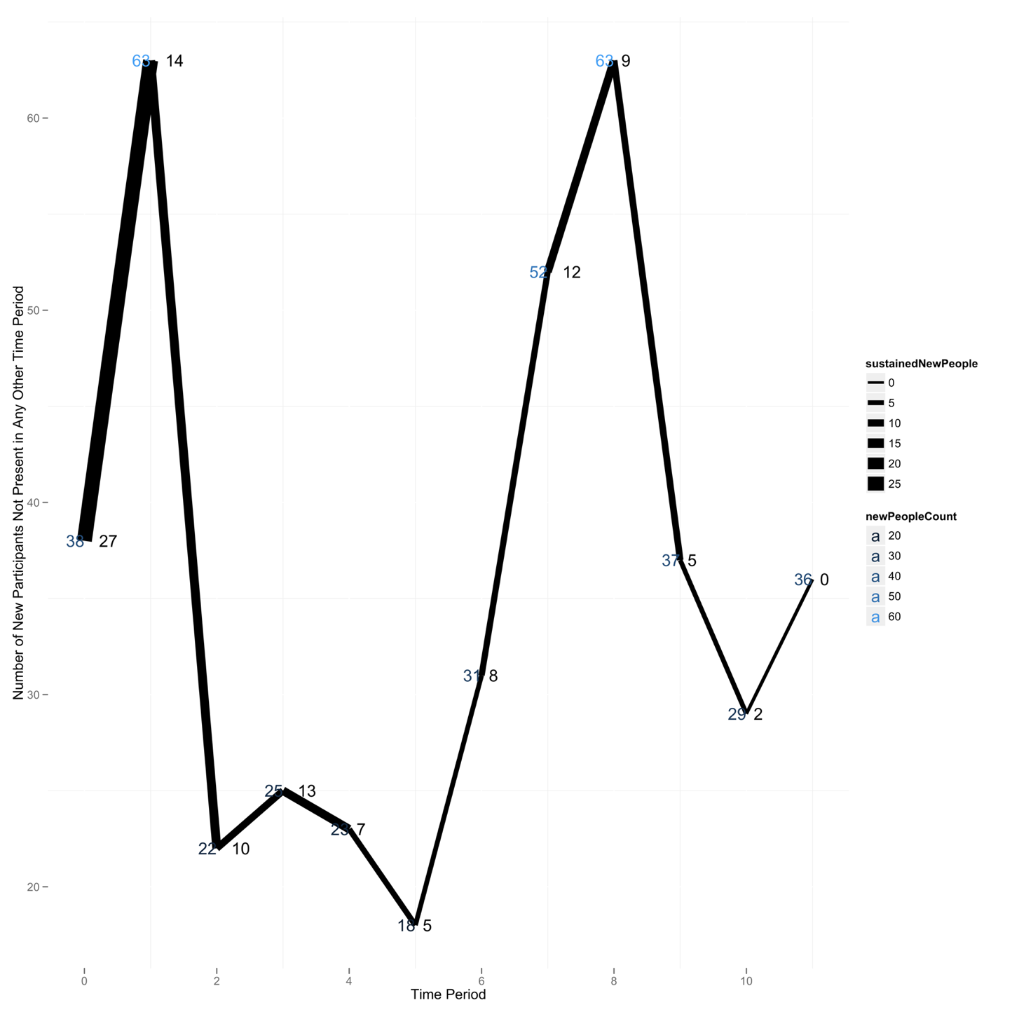
Github Participation
Over Time
Challenges
Studies Across Contexts
Applying Lessons in Learning
Examining Log Data

Slide 26

Github: Who’s Hangin’ with Gazay?
Challenges
Studies Across Contexts
Applying Lessons in Learning
Examining Log Data

Slide 27
Github: Participation Trajectory
Opening Issues
Adding Features
P5
These are
relatively similar dynamic trajectories
(same “trend”)
P2
P4
P3
This person has a different dynamic trajectory than P2-P4
P1
This is a “crystalized” position
Bug Fixes
Project Coordination

Slide 28
Studies Across Contexts
Big Social Data
Key Constructs: Discourse, Coordination, information diffusion
Challenges
Studies Across Contexts
Applying Lessons in Learning
Examining Log Data

Slide 29
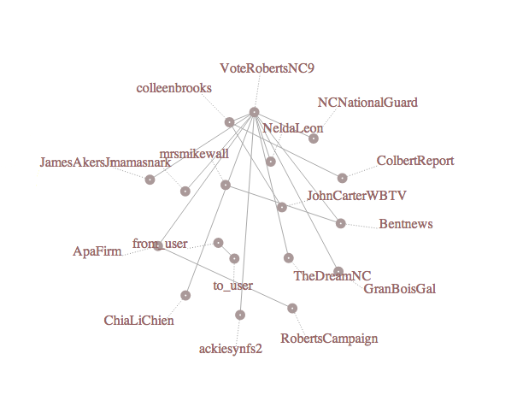
Live, Topical Twitter Networks
Challenges
Studies Across Contexts
Applying Lessons in Learning
Examining Log Data

Slide 30
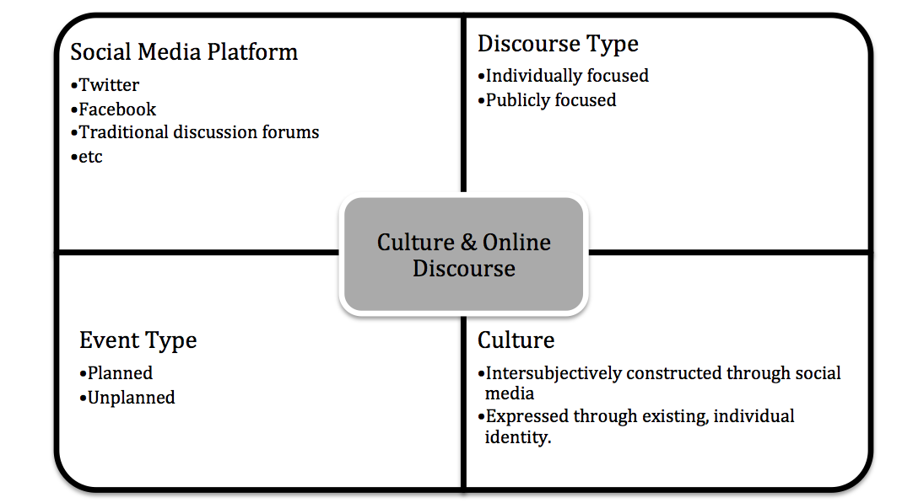
Big Social Data: Framing the Problem
Challenges
Studies Across Contexts
Applying Lessons in Learning
Examining Log Data

Slide 31
To Sum Up Big Social Data: Probabilistic Thinking to Instrument Learning and Information Behavior
Theory
Hypothesis
Data
Skepticism about your findings
Challenges
Studies Across Contexts
Applying Lessons in Learning
Examining Log Data

Slide 32
Learning Technology Design
Learning Technologies We use
Technologies We Use Every Day
My Approach
Building Measures and Indicators: Research Collaboration Technology in Learning Intensive Disciplines … where people are using that technology … so that we understand what works.
Study Informal Learning in Novel Contexts
Apply Lessons to Educational Technology Design
How do we get from A to B?
A
Pain
Fun
B

Slide 33
Thank You
Questions?
&
Sean P. Goggins, Ph.D
Challenges
Studies Across Contexts
Applying Lessons in Learning
Examining Log Data

Slide 34
This slide intentionally left blank
Challenges
Studies Across Contexts
Applying Lessons in Learning
Examining Log Data

Slide 35
This slide accidentally left blank
Challenges
Studies Across Contexts
Applying Lessons in Learning
Examining Log Data

